Slide 1
SRIJAN
Intelligent Expressions
VOLUME 8
DEPARTMENT OF COMPUTER SCIENCE
UNIVERSITY OF DELHI

Slide 2
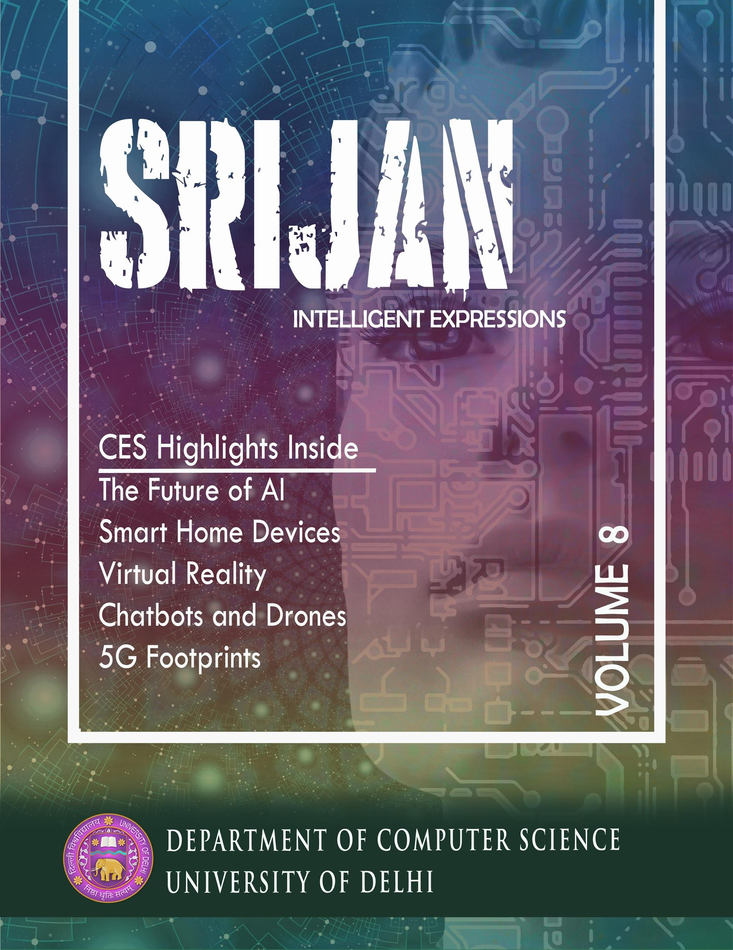
About SRIJAN
Srijan means creation.
Srijan started with an aim to capture the tremendous advancements in technology and lay out a bigger picture in a few words.
Since then, we have been trying to capture the highlights. Srijan aims at giving a complete roundup of the emerging tech within the field of computer science.

Slide 3
THEME of SRIJAN 2018
CES or the Consumer Electronics Show is the most significant annual trade show organized by the Consumer Technology Association in Las Vegas.
CES is huge, and it matters. CES has evolved to show us that what seems awkward and “for rich, lazy people” one year, becomes reasonable, practical, and available to everyone seemingly overnight.
CES
2018

Slide 4
SRIJAN 2018 HIGHLIGHTS
Virtual Reality
04
Drones
What if you could explore the surface of Mars? Swim with Dolphins? Fly a fighter jet?
Welcome to the world of Virtual Reality.
At CES 2018, audiences experienced the magic of Intel technology as a fleet of 250 Intel® Shooting Star™ drones lit up the night sky.
01
03
Smart Home Devices
Quantum Chip
Intel debuted the 49 qubit quantum chip which will revolutionize computing.
Alexa, Google Home and others are now smoothly integrating with our homes.
02

Slide 5
SRIJAN TEAM 2018
Ajay Jajoo (Chief Editor)
Jyoti Joshi (Chief Designer)
Megha Gupta (Editor & Designer)
Lakshya Sethi (Editor)
Sudhanshu Vishnoi (Editor)
Ashita Diwan (Editor)
Jatin Rohilla (Editor)
Shreshth Saxena (Designer)
Vipin Kumar (Designer)

Slide 6
Thank you!

